Slide 1
Using Large Language Models to Convert Documents to Knowledge Graphs to Check for Consistency and Completeness
Michael Wacey

Slide 2
Key Dates
Date | Meeting | Notes
11/2 |  | Praxis Proposal Completed and accepted
11/10 |  | First communication from advisor. Asked us to prepare two documents (Final Praxis Proposal and plan for completing Praxis). We have never discussed the plan that I put together. My plan contradicts the requirements since I would do chapters 2, 3, 4 and then 1,5 based on them.
11/15 | 1st Advisor | Focus was on updating my Praxis proposal, Advisor provided direction on updates
11/25 | Follow up with Advisor | Lots of issues with Praxis updates were identified and we agreed to leave it as is
12/6 | 2nd Advisor | Advisor shared work that he had done on data and identified that Praxis as proposed could not be accepted by the school. This was the first mention of Chapter 1 due date. Discussed meeting with the Department to address acceptance of Praxis.
12/9 | Follow up with Advisor | Advisor shared additional work done with the data and outlined an approach that was interesting but not the original plan of my Praxis
12/15 | Department Meeting | Refocus to work on creating a Knowledge Graph from a large document such as the Laws of a Pennsylvania township. Look at alternatives and which would be best for Consistency and Completeness checking. Identify the actual checking as future work.
12/20 | 3rd Advisor | End of semester

Slide 3
Proposed Milestones through April 1, 2025
Date | Milestone | Notes
1/4/2025 | Updated Proposal | Based on new approach the updated proposal.
1/11/2025 | Initial Cut Approach | Based on my concept as documented in the deck I shared, write a more detailed description of my approach.
2/1/2025 | Technical Environment Set up Complete | Licenses for Collab, LLM, Overleaf, GitHub, Visual Studio Code, RefWorks, etc. purchased and all tools configured.
2/1/2025 | Chapter 1 Complete | Chapter 1 of Praxis Complete
2/15/2025 | Chapter 2 Draft | Deeper research into the types of knowledge graphs and approaches to deriving them from large documents. I hope to identify at least three promising approaches.
3/1/2025 | Strengths and weaknesses identified | For each approach and resultant knowledge graph identify the strengths and weaknesses of the resultant knowledge graph. This may include processing additional documents for confirmation.
3/15/2025 | Chapter 3 Draft | Based on approach, testing, and research to date.
4/1/2025 | Define what is needed in a knowledge graph to check for consistency and completeness | This includes how to deal with nouns, verbs, statements of intent. It includes how to group parts of the graph into similar things (e.g., all parts that deal with land dimensions). It also includes being able to identify the source of the issue in the original document.
4/1/2025 | Chapter 2 Complete | Chapter 2 of Praxis Complete

Slide 4
Notes
My time from 11/2 until 12/15 has not been productive. I was doing research on my own per my original Praxis proposal
My advisor has with the best of intentions focused on changing my proposal and working with the data
We should have been focused on getting to a proposal that I am interested in and is doable – The meeting on December 15th did this
I will do everything in my power to get the work done by the original deadline – which I assume would be November 1, 2025
I would ask that the department allows me to go until December 20, 2025 – if needed – without additional charge

Slide 5
Status
Accomplishments
Defined new path forward for Praxis
In Progress
Updated research
Chapter 1
Setting up technical environment (OverLeaf, GitHub, Visual Studio Code, CoLab, RefWorks, etc.)
Plans
Research new path forward – multiple knowledge graphs
Complete Chapter 1
Start Chapter 2

Slide 6
Preparing the Praxis Chapters
Chapters
1. Introduction
2. Review of Literature
3. Methodology
4. Results
5. Conclusion and Future Research
1st Semester (short)
Chapter 1
2nd Semester (long)
Chapter 2
3rd Semester
Chapter 3
4th Semester
Chapters 4&5
Prepare for Defense
Failure to meet any of these deadline is grounds for giving a grade of orange for the semester and should be reported to the office

Slide 7
Preparing the Praxis Chapters
Fall 2024 (short)
Start Chapter 1 (Introduction)
Organize and outline Chapter 2 (Review Literature), start Chapter 2
Start thinking about experiments
Spring 2025 (long)
Continue writing Chapter 2
Organize and outline Chapter 3 (Methodology), start Chapter 3
Start working on experiments
Summer 2025 (short)
Continue working on experiments
Organize and outline Chapter 4 (Results), start Chapter 4
Fall 2025 (long)
Wrap up working on experiments
Organize and outline Chapter 5 (Conclusion and Future Research)
Finalize Praxis Paper and prepare for submittal
Submit to AIR
Submit to Defense Committee
Conduct Praxis Defense

Slide 8
Response to Advisor Feedback from previous meeting(s)

Slide 9
Progress Since Last Meeting

Slide 10
Issues Encountered and Setbacks

Slide 11
Tasks for the Next Two Weeks
Literature review summary document ( I am not looking for a formal document, but at least a list of 20+ Journal papers (minimize the conference papers) with brief notes summarizing the methods, datasets, metrics used, findings relevant to document classifications, Document coherence, etc.
A comparative analysis table highlighting how different methods perform against key metrics such as accuracy, precision, recall, adaptability, and computational cost.
Note (1) and (2) will help you prepare the content for chapter 2 (literature review).
3) Provide an initial version of cleaned and preprocessed datasets for further analysis and modeling.
4) Provide an initial exploratory data analysis (EDA) report that includes visual insights and feature importance ranking for early understanding of the data.
Create plots like histograms, boxplots, scatter plots, and heatmaps to understand the distribution and relationships between variables.
Visualize outliers and missing data patterns.
Use basic methods (e.g., correlation coefficients, simple tree-based models) to rank features by their importance.
Identify potential key variables relevant to fraud detection
Note: You can use any format you like; what matters to me is the content you provide.

Slide 12
Glossary of Terms
Term | Definition
Coherence | Coherence in documents refers to the logical and smooth flow of ideas or information from one sentence to the next and throughout the entire piece. It's about how well the different parts of the document connect and make sense together.
Completeness | Completeness in documents refers to the thoroughness and comprehensiveness of the information presented. It means that the document contains all the necessary details to effectively convey its message or fulfill its purpose.
Consistency | Consistency of content in documents refers to the coherence and uniformity of the information presented. It ensures that the ideas and arguments flow logically, and that there are no contradictions or inconsistencies in the facts or claims.
Dynamic GNN | A dynamic GNN (Graph Neural Network) is a type of GNN specifically designed to handle graphs that evolve over time. In traditional GNNs, the graph structure remains fixed throughout the learning process. However, in many real-world applications, the relationships between nodes in a graph can change dynamically. Dynamic GNNs are equipped to handle such scenarios.
Transformer | A transformer is a neural network architecture that uses an attention mechanism to process input data in parallel, making it highly effective for tasks like machine translation and text summarization.

Slide 13
Acronyms
Acronym | Definition
AI | Artificial Intelligence
GAT | Graph Attention Networks
GCNN | Graph Convolutional Neural Network
GNN | Graph Neural Network
ML | Machine Learning
NER | Named Entity Recognition

Slide 14
Problem Statement
(A) Deliverable | (B) Format | (C) WC
Issue | Checking that documents are complete and consistent is difficult (NASA, 1999). | 9
Reference | NASA (1999). Mars Climate Orbiter Mishap Investigation Board Phase I Report. Retrieved from https://llis.nasa.gov/llis_lib/pdf/1009464main1_0641-mr.pdf | NA
”so what” | As an example, document inconsistencies cost NASA $198 Million on the Mars Climate Orbiter (NASA, 1999). | 14
Reference | NASA (1999). Mars Climate Orbiter Mishap Investigation Board Phase I Report. Retrieved from https://llis.nasa.gov/llis_lib/pdf/1009464main1_0641-mr.pdf | NA
Problem statement | Checking that documents are complete and consistent is difficult (NASA, 1999), as an example document inconsistencies cost NASA $198 Million on the Mars Climate Orbiter (NASA, 1999). | 23
Industry | Engineering and Law | NA
PS elaboration 1 | Documents that are authored by multiple people over time inevitably develop inconsistencies and are incomplete, even with multiple reviews these often are never identified and resolved. | 26
PS elaboration 2 | If one law says that a fee is needed to cover costs, but another law says that fees cannot be collected, the township will have to use taxpayer money. | 29

Slide 15
Thesis Statement
(A) Deliverable |  | WC
Thesis Statement | A transformer-based tool to check a document for consistency and completeness will reduce the negative implications of these mistakes, saving considerable money. | 28
Research Product | Transformer-based tool | NA
Format | Python Program | NA
Deliverable Usage | Lawyers who draft new regulations will use the tool to check if the new regulation adds any inconsistencies. | 18
Tie back to PS | Inconsistent and incomplete laws are found sooner and resolved thereby eradicating their cost to the municipality and taxpayers. | 18
New Contributions | Work has focused on financial documents and business requirements to date. It has not leveraged the power of transformers. | 19
Scope | I am using municipal laws due to the free availability of laws. The tool should be able to work on any large documents. | 23
Main methodology | Transformers | NA
Inputs | A subset of the laws of the 1,456 Pennsylvania Townships of the Second Class, Easttown Township (DOCX), Willistown Township (DOCX), etc. | NA
Outputs | Laws annotated with anything that is inconsistent or incomplete in DOCX format. | NA

Slide 16
Research Questions
(A) Deliverable | (B) Format | (C) WC
Research Question 1 | Can a neural network-based model accurately determine consistency and completeness of a law document? | 15
Research Question 2 | Which of GNN, CNN, or transformers most accurately determines consistency and completeness of a law document? | 16
Research Question 3 | Can using a GNN to label entities, such as a person or a company, be used to accurately determine consistency and completeness of law document? | 25

Slide 17
Research Hypotheses
(A) Deliverable | (B) Format | (C) WC
Hypothesis 1 | A neural network-based model can accurately determine consistency and completeness of a law document. | 15
Independent Variables | Words, sentences, paragraphs in a law document that has been checked for inconsistencies and incompleteness by lawyers and compilers. | NA
Dependent Variable | Identifies inconsistencies or incompleteness | NA
Testable | Switch paragraphs in documents and see if the model detects the inconsistency. Remove paragraphs and see if the model detects the incompleteness. | 22
Hypothesis 2 | Transformers perform more accurately than a GNN or CNN, to determine the consistency and completeness of a law document. | 19
Independent Variables | Words, sentences, paragraphs in a law document that has been checked for inconsistencies and incompleteness by lawyers and compilers. | NA
Dependent Variable | Identifies inconsistencies or incompleteness | NA
Testable | Implement multiple models based on Transformers, GNNs, and CNNs and compare their accuracy. | 15
Hypothesis 3 | Using a GNN to label entities can be used to determine the consistency and completeness of a law document. | 19
Independent Variables | Words, sentences, paragraphs in a law document that has been checked for inconsistencies and incompleteness by lawyers and compilers. | NA
Dependent Variable | Identifies inconsistencies or incompleteness | NA
Testable | Review generated GNN graphs to identify differences between graphs of consistent/inconsistent and complete/incomplete entities. | 16

Slide 18
Annotated Bibliography (1 of 5)
(A) Deliverable | (B) Format | (C) WC
Reference | Laban, P., Dai, L., Bandarkar, L., & Hearst, M. A. (2021). Can Transformer Models Measure Coherence In Text? Re-Thinking the Shuffle Test. arXiv (Cornell University), 10.48550/arxiv.2107.03448 | NA
Summary | Introduces the concept of coherence and the difficulty defining it. Summarizes the various ways to measure coherence and focuses on the shuffle test. Shows that the shuffle test can have a perfect score but still not measure coherence. | 10 13 15
Methodology | GPT-2 | NA
Evaluation | Aggregate model performance drops from 94.5% for block-size 1 to 77.9% for block-size 5. Identifies the problem that shuffle test can be perfect without measuring coherence. Identifies a solution (zero shot shuffle test) that does as well as humans, 97.5% for human's vs 94.5 for average model. | 14 12 21
Relevance | Provided me with the term coherence for consistency. Provided me with many references on coherence and how to test it. Confirmed that this is a problem being researched. | 8 12 8

Slide 19
Annotated Bibliography (2 of 5)
(A) Deliverable | (B) Format | (C) WC
Reference | Gemelli, A., Biswas, S., Civitelli, E., Lladós, J., & Marinai, S. (2022). Doc2Graph: a Task Agnostic Document Understanding Framework based on Graph Neural Networks. (). Ithaca: Cornell University Library, arXiv.org. 10.48550/arxiv.2208.11168 Retrieved from Publicly Available Content Database https://www.proquest.com/docview/2706457673/abstract/ | NA
Summary | Historically documents have been understood as they relate to specific tasks. This article takes a structural approach to understanding documents using GNNs. The approach is applied to form and invoice understanding. | 11 11 9
Methodology | Graph Neural Networks (GNN) | NA
Evaluation | The article compares the GNN approach to existing approaches. They have a good F1 on forms (0.82 vs 0.81) and a better F1 (0.37 vs 0.31) on invoices. But they only need 6.2 x 10⁶ parameters vs 138 x 10⁶ parameters. | 9 19 13
Relevance | I had planned to use GNNs to process the documents, and this seems very related to that. It provides me with a start on how to process documents into a form that can be used for consistency and completeness checks. | 17 23

Slide 20
Annotated Bibliography (3 of 5)
(A) Deliverable | (B) Format | (C) WC
Reference | Yang, J., Yoon, S., Kim, B., & Lee, H. (2024). FIZZ: Factual Inconsistency Detection by Zoom-in Summary and Zoom-out Document. arXiv (Cornell University), 10.48550/arxiv.2404.11184 | NA
Summary | A new approach to check that the summary of a document is consistent with a document. Break the summary down into Atomic Facts. Compare Atomic Facts to the original document. | 16 7 7
Methodology | Natural Language Inference (NLI) | NA
Evaluation | They only looked at article and news domains, no results for other domains. The tool does not create the summaries. Higher interpretability by breaking it down into Atomic Facts. FIZZ performed with highest average accuracy (71.2) on two standard data sets (AggreFact-Cnn, AggreFact-XSum). | 13 7 9 14
Relevance | This will be useful to break a document down for analysis, into the Atomic Facts. The approach works well but is slow. | 15 7

Slide 21
Annotated Bibliography (4 of 5)
(A) Deliverable | (B) Format | (C) WC
Reference | Aumiller, D., Almasian, S., Lackner, S., & Gertz, M. (Jun 21, 2021). Structural text segmentation of legal documents. Paper presented at the 2–11. 10.1145/3462757.3466085 | NA
Summary | They use LLMs to process legal documents into a standard structure. Most previous work focused on sentences while this work focuses on paragraphs. The data they use is Terms of Service from over 70,000 web sites where they have extracted section headings to use as labels. | 11 12 23
Methodology | Transformers using models from Hugging Face. | NA
Evaluation | They show improvement in errors with their method over prior methods Ensemble approaches performed better. For example, one prior method had an error rate (misclassification of a section) of 32.28 while the authors approach had an error rate of 12.95. | 11 4 25
Relevance | This paper makes it clear that Transformers can be used to understand legal documents and their structure. There are many references in this paper that will help me. My expectation had been that paragraphs would be the right unit to work with and this confirms that. | 17 11 18

Slide 22
Annotated Bibliography (5 of 5)
(A) Deliverable | (B) Format | (C) WC
Reference | Carbonell, M., Riba, P., Villegas, M., Fornes, A., & Llados, J. (Jan 10, 2021). Named Entity Recognition and Relation Extraction with Graph Neural Networks in Semi Structured Documents. Paper presented at the 9622–9627. 10.1109/ICPR48806.2021.9412669 https://ieeexplore.ieee.org/document/9412669 | NA
Summary | The task is to take a document, group words that relate to an entity, label the entities, and identify pair wise relationships between entities. They use a GNN to learn how to do these tasks. They use the FUNSD and IEHHR datasets. | 24 11 7
Methodology | GNN, k-NN, GAT | NA
Evaluation | They compare F1 scores for labeling and linking to previous work on the FUNSD data set and show an F1 of 0.64 on labeling and 0.39 on linking which is better for linking but worse for labeling. For IEHHR they have 0.53 for labeling and 0.67 for linking but there is no prior work on this data set. | 37 21
Relevance | This will provide me with an approach to understand the main entities of the law documents. This shows how to use a GNN to process a law document. | 16 12

Slide 23
Data Sources List
ID | Name | Source | Brief Description | Format | Time Span | Num. of records | Access (Y/N)
1 | Easttown Code | eCode 360 - https://ecode360.com/EA3052 | The Laws of Easttown Township, Pennsylvania as enacted by the Board of Supervisors. | Word File | About 1940 to 10/16/2023 | 4.42 MB and 732 pages and 288,412 words | Y
2 | Tredyffrin Code | eCode 360 - https://ecode360.com/TR1485 | The Laws of Tredyffrin Township, Pennsylvania as enacted by the Board of Supervisors. | Word File | About 1940 to 6/17/2024 | 6.69 MB and 819 pages and 318,231 words | Y
3 | .. | .. | .. | .. | .. | .. | ..

Slide 24
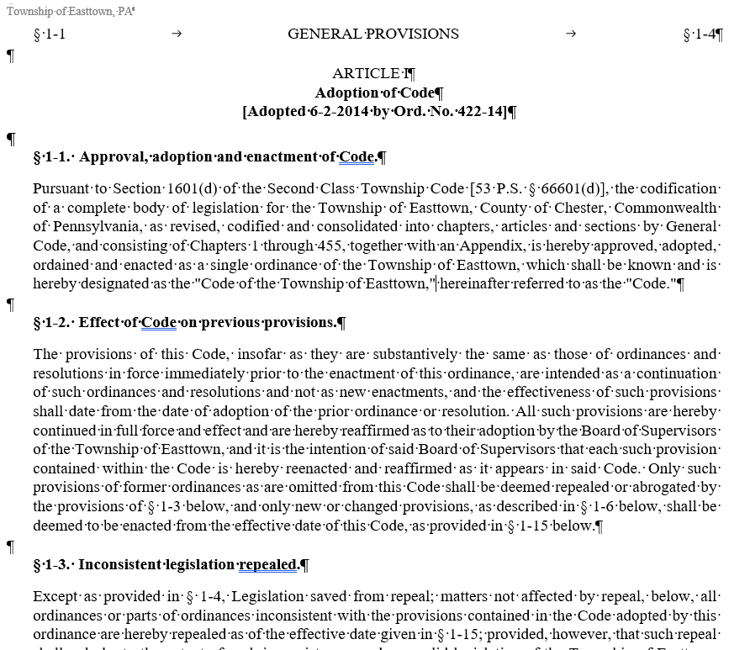
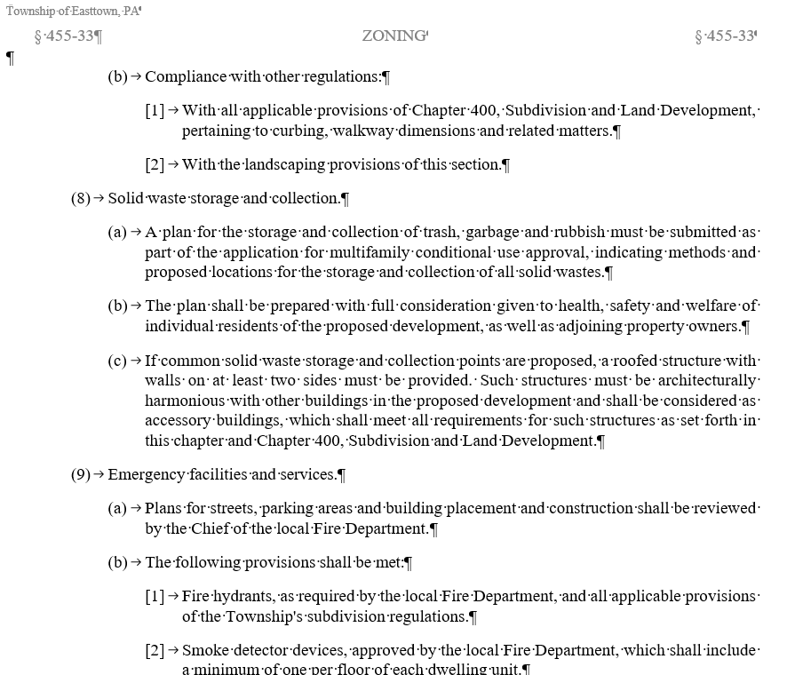
Data Source Example
ID | Name | Source | Brief Description | Format | Time Span | Num. of records | Access (Y/N)
1 | Easttown Code | eCode 360 - https://ecode360.com/EA3052 | The Laws of Easttown Township, Pennsylvania as enacted by the Board of Supervisors. | Word File | About 1940 to 10/16/2023 | 4.42 MB and 732 pages and 288,412 words | Y
Item | Description | WC
Purpose | Provides me with real world examples of large law documents that I can manipulate to create inconsistences and incompleteness. | 19
Data Treatment | For some of these documents, I will inject inconsistency and remove sections to make it incomplete. The document will be processed by a GNN to create a graph that documents the entities within the document. The graph will be processed by a Transformer to identify inconsistent or incomplete entities. | 16 19 14
Page 3 of the document. I looked for a table of contents but did not find one.
Page 531 of the document.

Slide 25
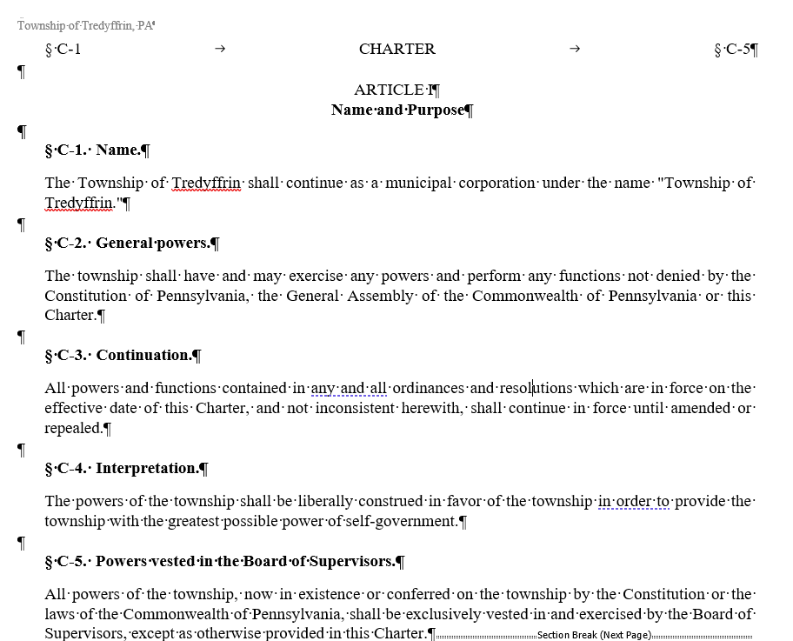
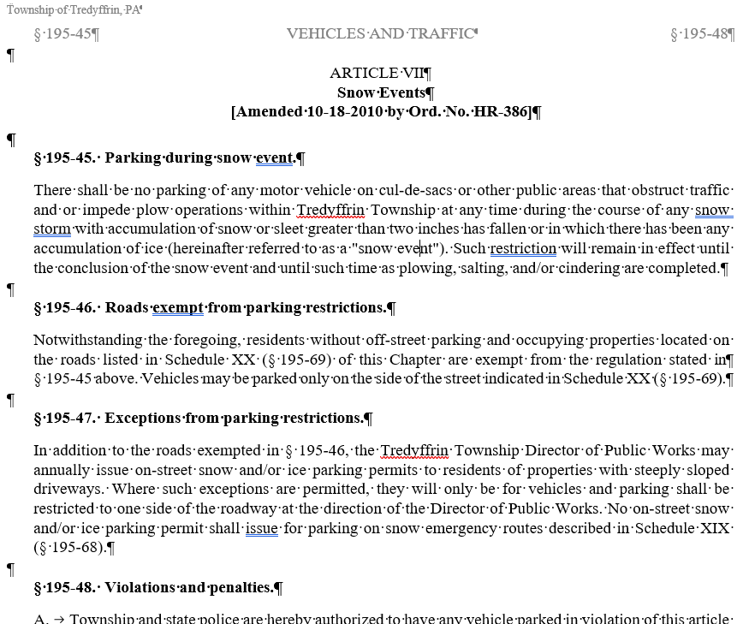
Data Source Example
ID | Name | Source | Brief Description | Format | Time Span | Num. of records | Access (Y/N)
2 | Tredyffrin Code | eCode 360 - https://ecode360.com/TR1485 | The Laws of Tredyffrin Township, Pennsylvania as enacted by the Board of Supervisors. | Word File | About 1940 to 6/17/2024 | 6.69 MB and 819 pages and 318,231 words | Y
Item | Description | WC
Purpose | Provides me with real world examples of large law documents that I can manipulate to create inconsistences and incompleteness. | 19
Data Treatment | For some of these documents, I will inject inconsistency and remove sections to make it incomplete. The document will be processed by a GNN to create a graph that documents the entities within the document. The graph will be processed by a Transformer to identify inconsistent or incomplete entities. | 16 19 14
Page 3 of the document. I looked for a table of contents but did not find one.
Page 531 of the document.

Slide 26
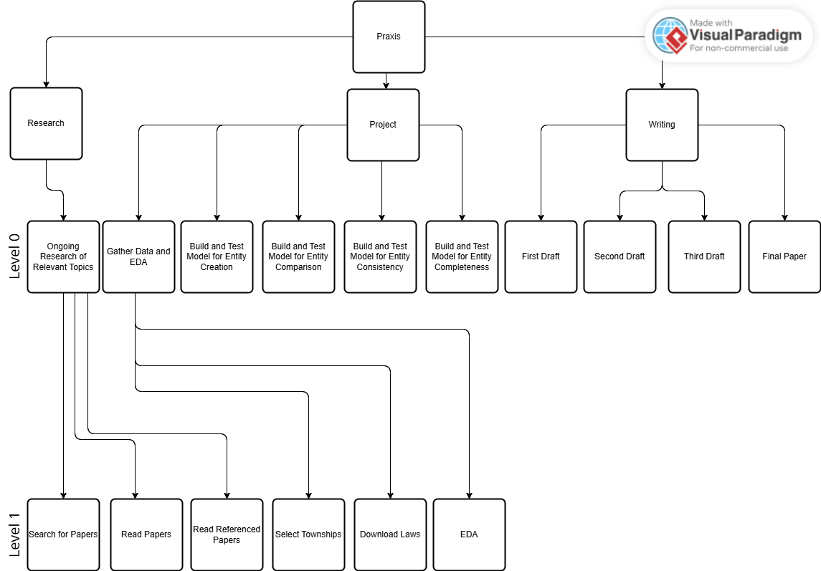
Hierarchy

Slide 27
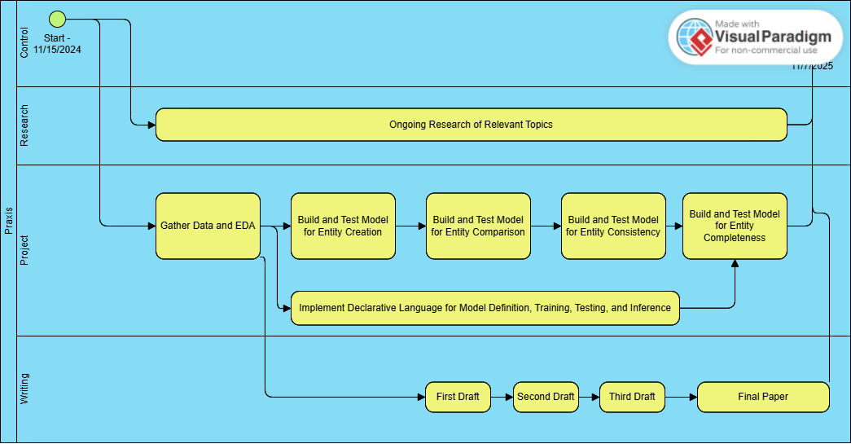
Level 0

Slide 28
Level 0
Item | What? | Why? | How?
Start | Begin the work. | Every journey begins with the first step.
Ongoing Research of Relevant Topics | Continue searching for and reading papers relevant to the topic. The current tags are Coherence, Completeness, GNN, Law, Named Entity Recognition, NASA, Ontology, Transformer | Ensure that I am up to date on the latest approaches. Look for comparisons to ensure I am delivering an improvement. Keep abreast of any competing work. | All references will be stored in RefWorks. I will search for works and use citations from works I have found.
Gather Data and EDA | Download a significant number of Pennsylvania Township laws in Word format. There are over 1,200 townships in Pennsylvania. | These will be my primary data for my project. | I have access to General Code which lets me do these downloads.

Slide 29
Level 0
Item | What? | Why? | How?
Build and Test Model for Entity Creation | Take the documents I have downloaded and use a GNN to create entities based on the text. Each entity must have a well-defined type. The set of types should be Mutually Exclusive and Completely Encompassing (MECE). | The entities will be how completeness and consistency will be checked. Completeness will be checked by verifying there are no missing parts of an entity. Consistency will be checked by verifying that all entities of the same type have the same parts. | Process the document with a GNN to form a graph of the document. The graph will contain the entities. Typically, a GNN will use a fixed predefined graph. There has been some work on dynamic graphs, and I will plan on leveraging that work.
Build and Test a Model for Entity Comparison Research Question 2 Research Question 3 | Based on the document graph and the entity types compare entities of the same type. Develop a score that indicates how similar they are structurally, not by content. | This will be the bases of the check for consistency and completeness. The initial score will show that the entities can be compared. In future phases the score will be updated to reflect consistency and completeness. | TBD

Slide 30
Level 0
Item | What? | Why? | How?
Build and Test Model for Entity Consistency Research Question 1 | Using the entity consistency approach determine if all entities in a document are consistent. Create a score and flag any that are more different than the score. {I need to address inferences between entities. If one entity implies that another will exist or will have certain values, this needs to be flagged.) | TBD | TBD
Build and Test a Model for Entity Completeness Research Question 1 | Using the entity consistency approach determine if an entities are missing significant pieces. | TBD | TBD

Slide 31
Level 0
Item | What? | Why? | How?
Implement Declarative Language for Model Creation and Use | An SQL like language that has CREATE MODEL, TRAIN MODEL, etc. It simply generates and then runs the appropriate Python / PyTorch code. | I am lazy and do not want to have to write the same code repeatedly. | Use ANTLR to define the grammar and implement it in Java to generate the correct Python / PyTorch.

Slide 32
Level 0
Item | What? | Why? | How?
First Draft | Literature Review
Second Draft | Literature Review, Methodology
Third Draft | Literature Review, Methodology, Abstract, Introduction, and Conclusions
Final Paper | Based on feedback and review create the final version for submission.

Slide 33
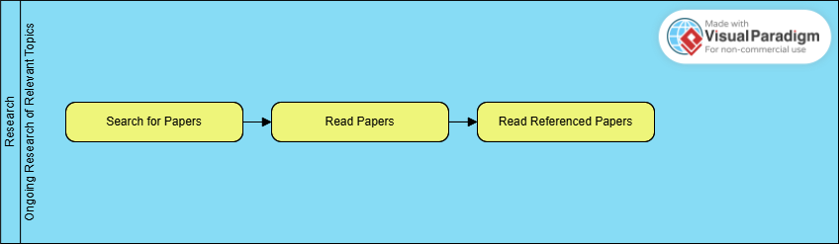
Level 1 – Ongoing Research of Relevant Topics

Slide 34
Level 1 – Ongoing Research of Relevant Topics
Item | What? | Why? | How?
Search for Papers | Perform searches based on the tags and concepts relevant to the project.
Read Papers | Initially skim each paper to understand if it might be relevant. |  | Store relevant papers in RefWorks.
Read Referenced Papers

Slide 35
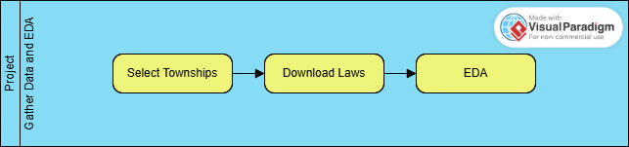
Level 1 – Gather Data and EDA

Slide 36
Level 1 – Gather Data and EDA
Item | What? | Why? | How?
Select Townships | Identify a significant but reasonable set of townships to use. The working assumption is that about 100 will be good.
Download Laws | Go to eCode 360 and download the laws in DOCX format for the identified townships. Catalog the downloaded files.
EDA | There is not much to do here.

Slide 37
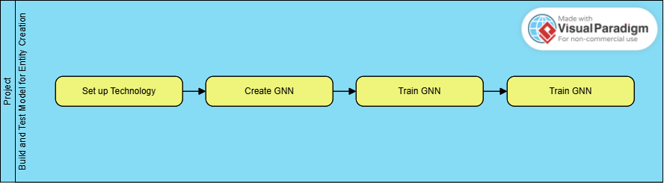
Level 1 – Build and Test Model for Entity Creation

Slide 38
Level 1 – Build and Test Model for Entity Creation
Item | What? | Why? | How?
Set up Technology | Ensure that Google Collab is ready to go. Confirm Github integration. Is there a role for Visual Studio Code?
Create GNN
Train GNN
Test GNN

Slide 39
Appendix

Slide 40

Appendix B Chapter Guidelines

Slide 41
General Chapter Guidelines
Chapter 1 Introduction (5 pages)
Should answer:
What are you doing?
Why is it important?
What have others done?
What are you doing that’s different or better?
What do you hope to achieve?
Chapter 2 Literature Review (25-30 pages)
Should be a comparing and contrasting of the work done on the subject to date.
Should be well organized and easy to follow
This should be based on 40+ references

Slide 42
General Chapter Guidelines
Chapter 3 Methodology (25-30 pages)
No qualitative research methods (survey, grounded theory, etc.).
No method that requires the IRB
Describe any data, data manipulation, and data cleaning used
Explain the methodology with its strengths and weaknesses
Explain any variation of the methodology required to address the problem in the praxis
Chapter 4 Results (25-30 pages)
Using the results from the methodology, lead the reader through the proof of the research hypotheses
Clearly state all findings using tables and graphics

Slide 43
General Chapter Guidelines
Chapter 5 Conclusions (~5 pages)
Discuss the results of proving the research hypotheses
Clearly state any weakness or limitation in the analysis
Clearly state the scope of the study and its implications
Provide a roadmap for future research
References (5-10 pages)
Minimum 40 references

